Slide 1

Car accidents analysis

Slide 2
Meet the Team
Team Leader & Data Analyst Data Modelling Data Engineers
Mary Prashanthi Vongala Sravya Kaitha Alekya Basike
Karthik Reddy Thumma

Slide 3


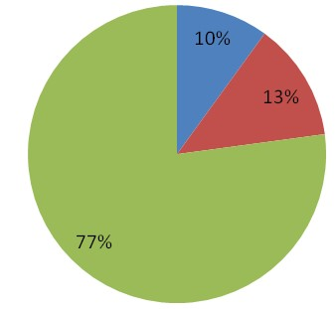
The Problem
Casualty analysis
Identifying Hotspot locations of car accidents
Studying the impact of precipitation/other environmental factors
3

Slide 4
The Solution
Will calculate real-time car accident prediction, studying car accidents hotspot locations, casualty analysis and extracting cause and effect rules to predict car accidents.
Plot the graph between severity and weather, temperature and humidity to know the how the severity level depends on weather conditions.

Slide 5
CRISP-DM
Business understanding
Project Objective
Deploy the Application in AWS and Automate
Deployment
Data
Understanding
Data Exploration
Data
Evaluation
Data
Preparation
Evaluating the Metrics
Feature Engineering
Modeling
Predicting Potential customers using machine learning algorithms

Slide 6








Graphical representation of ETL tools

Slide 7

Statistics
2023
5.2M Road Accidents (Expected)
2022
4.8M Road Accidents as per reports
2021
4M Road accidents as per reports
5.2M
4.8M
4M

Slide 8
Technology/expertise
Jupyter Notebook
Data cleaning using Pandas, Numpy
KNN Algorithm
To remove outliers, missing data, identifying the predictive modeling approach and process the data into a suitable model.
MODEL
Model evaluation
We will choose the optimal algorithm based on the accuracy measured using several ML methods.

Slide 9
Technology/expertise
Model Deployment
Flask and Github
MODEL
Data Visualization
Matplotlib, seaborn, PowerBi tool to visualize the data.

Slide 10
Metrics milestones
Milestone #1
To create a Dataset with null and no values.
Milestone #2
Metrics
To obtain Highest accuracy comparatively
Milestone #3
visualizing the data and Finding the hotspot locations.

Slide 11

Thank You

